Slide 1
Diabetes Patient Prediction
R-Programming
Project

Slide 2
What We are going through
01
02
03
Problem Statement & Objective
Process To Solve
Conclusion

Slide 3
01
PROBLEM STATEMENT

Slide 4
Problem Statement & Our Objective
This dataset is originally from the National Institute of Diabetes and Digestive and Kidney Diseases. The objective of the dataset is to diagnostically predict whether or not a patient has diabetes, based on certain diagnostic measurements included in the dataset. Several constraints were placed on the selection of these instances from a larger database. In particular, all patients here are females at least 21 years old of Pima Indian heritage.

Slide 5
02
PROCESS TO SOLVE

Slide 6
Process To Solve
We have our data saved in a CSV file called diabetes.csv. We first read our dataset through read.csv function built in R .
The following features have been provided to help us predict whether a person is diabetic or not:
Pregnancies
Glucose
BloodPressure
SkinThickness
Insulin
BMI
DiabetesPedigreeFunction
Age
Outcome: Class variable (0 if non-diabetic, 1 if diabetic)

Slide 7
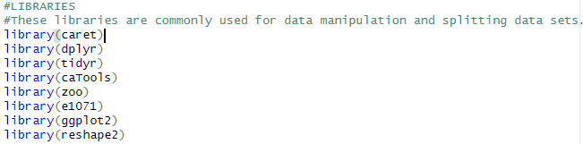
Process To Solve (Cont.)
This code is for building a support vector machine (SVM) classifier to predict diabetes status based on the given input features.
Loading necessary libraries: The code loads several libraries such as caret, dplyr, ggplot2, and others that are commonly used for data manipulation, visualization, and machine learning.

Slide 8

Process To Solve (Cont.)
Loading the dataset: The code loads the diabetes dataset from a CSV file using the read.csv() function and stores it in a data frame named diabetes.dataset.
Plotting the data distribution before cleaning: The code uses ggplot2 library to plot histograms of all features in the dataset before cleaning to understand the data distribution.

Slide 9
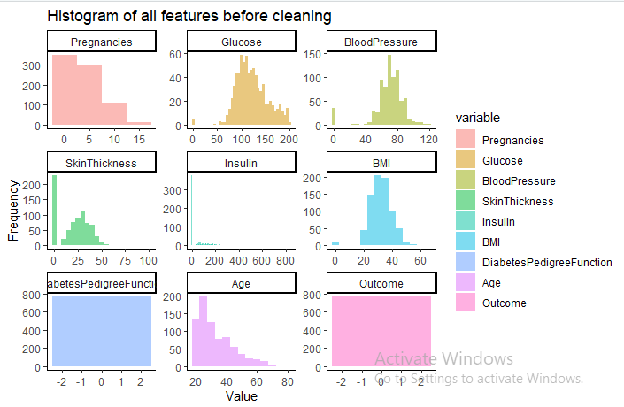
Process To Solve (Cont.)

Slide 10

Process To Solve (Cont.)
Data Cleaning: The code performs the following data cleaning steps:
Removing duplicates using the distinct() function
Imputing missing values using mean imputation with na.aggregate() function
Plotting the data distribution after cleaning: The code again plots histograms of all features in the cleaned dataset using ggplot2 library to check the distribution of data after cleaning.

Slide 11
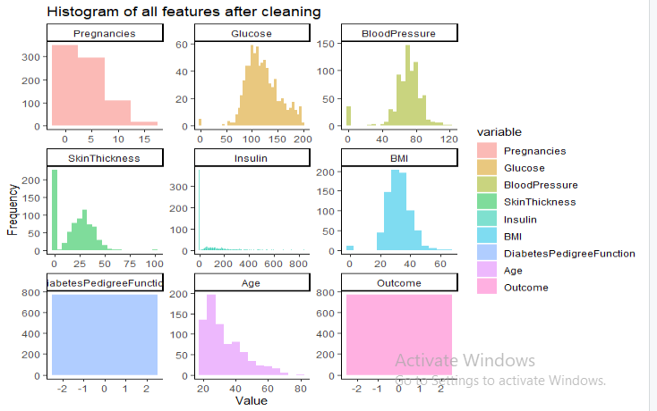
Process To Solve (Cont.)

Slide 12
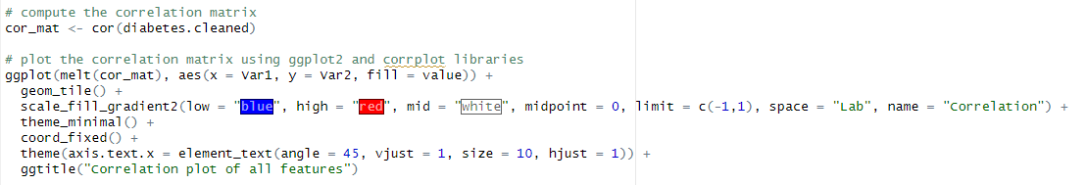
Process To Solve (Cont.)
Computing correlation matrix: The code uses cor() function to compute the correlation matrix of the cleaned dataset.
Plotting correlation matrix: The code uses ggplot2 and corrplot libraries to plot the correlation matrix in a heat map.

Slide 13
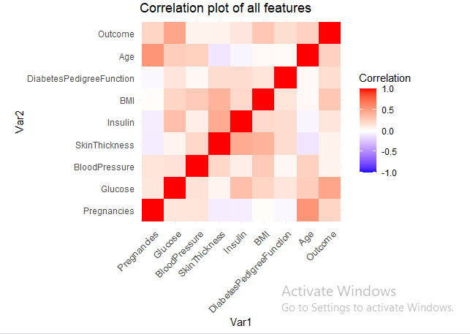
Process To Solve (Cont.)

Slide 14
Process To Solve (Cont.)
Converting the Outcome column to a factor: The code converts the Outcome column to a factor using the as.factor() function.
Getting statistical measures: The code uses the summary() function to get the statistical measures of the cleaned dataset.
Value counts of the Outcome column: The code uses the table() function to get the value counts of the Outcome column.
Mean of the Outcome column based on diabetes status: The code groups the cleaned dataset by Outcome column and calculates the mean of all columns using group_by() and summarize_all() functions.

Slide 15
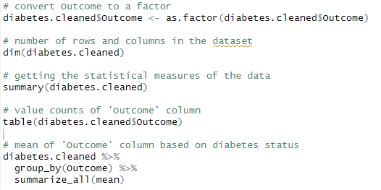
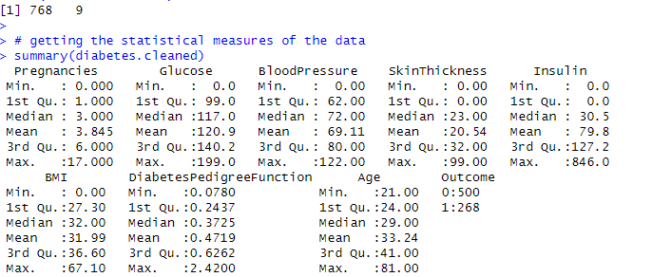
Process To Solve (Cont.)
OUTPUT :-

Slide 16
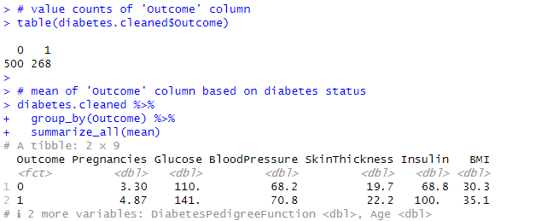
Process To Solve (Cont.)
OUTPUT :-

Slide 17
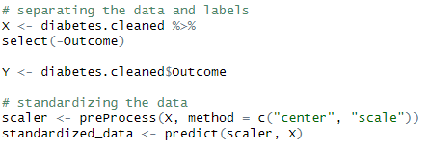
Process To Solve (Cont.)
Separating the data and labels: The code separates the input features and the target variable into two separate data frames X and Y, respectively.
Standardizing the data: The code uses the preProcess() function from the caret library to standardize the input features.

Slide 18
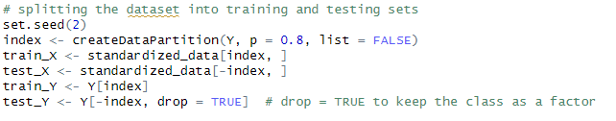
Process To Solve (Cont.)
Splitting the dataset: The code uses the createDataPartition() function from the caTools library to split the dataset into training and testing sets.

Slide 19

Process To Solve (Cont.)
Training the SVM classifier: The code trains the SVM classifier using the svm() function from the e1071 library.

Slide 20

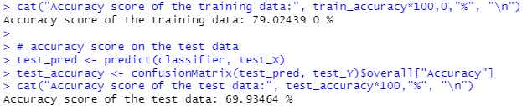
Process To Solve (Cont.)
Accuracy score on the training data: The code uses predict() function to predict the Outcome for the training set and calculates the accuracy score using confusionMatrix() function from the caret library.
Accuracy score on the test data: The code uses the trained SVM classifier to predict the Outcome for the test set and calculates the accuracy score using confusionMatrix() function.
OUTPUT :-

Slide 21
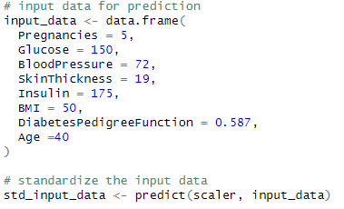
Process To Solve (Cont.)
Input data for prediction: The code creates a new data frame input_data with input values for a new sample.
Standardizing the input data: The code uses the predict() function with the scaler object (created in step 13) to standardize the input data.

Slide 22
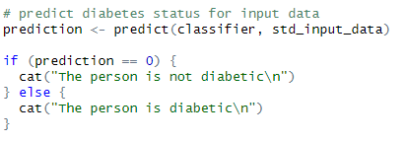
Process To Solve (Cont.)
Predicting diabetes status for input data: The code uses the trained SVM classifier to predict the diabetes status for the input data and displays the result.

Slide 23
03
CONCLUSION

Slide 24
CONCLUSION
First, it loads a dataset, then performs data cleaning by removing duplicates and imputing missing values. Next, it standardizes the data to prepare it for modeling. The code then splits the data into training and testing sets for building and evaluating a machine learning model.
The code trains a support vector machine (SVM) classifier on the training set and reports the accuracy score on both the training and testing sets to evaluate the model's performance. Finally, the code uses the trained classifier to make predictions on new input data.
This code demonstrates several key steps in a typical data science workflow, including data cleaning, data preprocessing, feature engineering, model building, and evaluation. These steps are essential for producing reliable and accurate models that can be used for real-world decision-making.
Next, we will use our test data to find out accuracy of the model.
The print statement will print accuracy is 69.93%

Slide 25
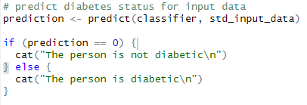
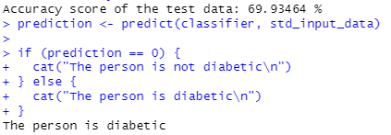
CONCLUSION
OUTPUT :-

Slide 26
That’s All about the Diabetes Prediction Project
Thankyou

